Slide 1
Unit 1
Biological Systems and Environmental Change

Slide 2
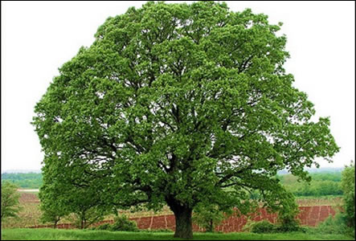
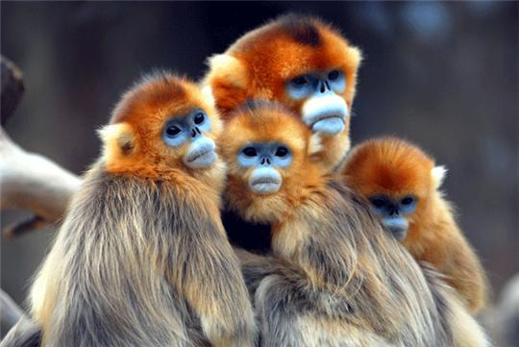
4 Characteristics of ALL living things

Slide 3
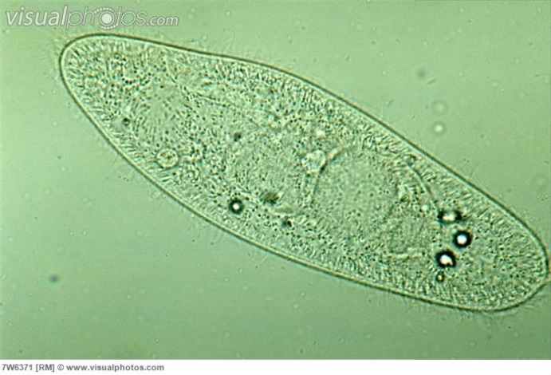
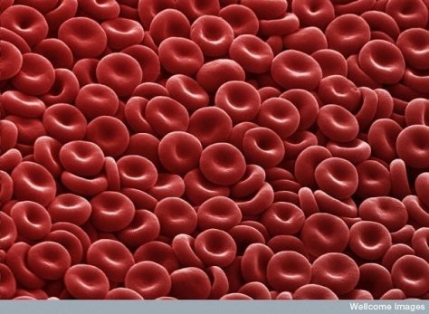
All living things are made up of one or more cells.
Cell: the basic unit of life

Slide 4
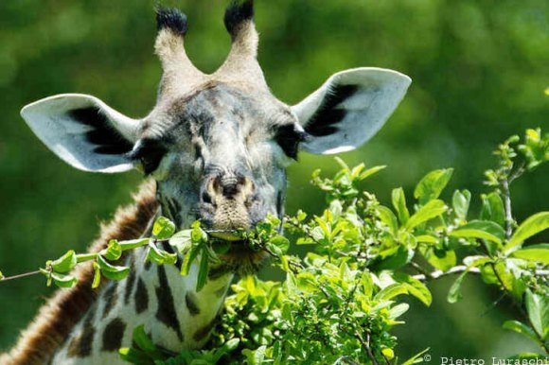
All living things need chemical energy.
animals – must eat food to get chemical energy
plants – must use sunlight to make their own food for chemical energy

Slide 5
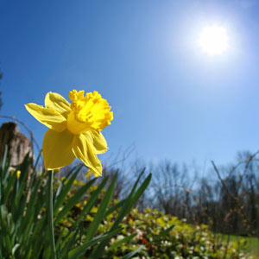
3. All living things must react to their environment.
plants – move toward the light

Slide 6
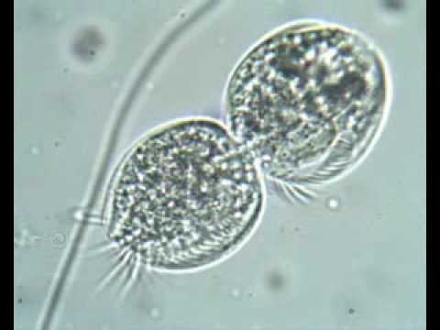
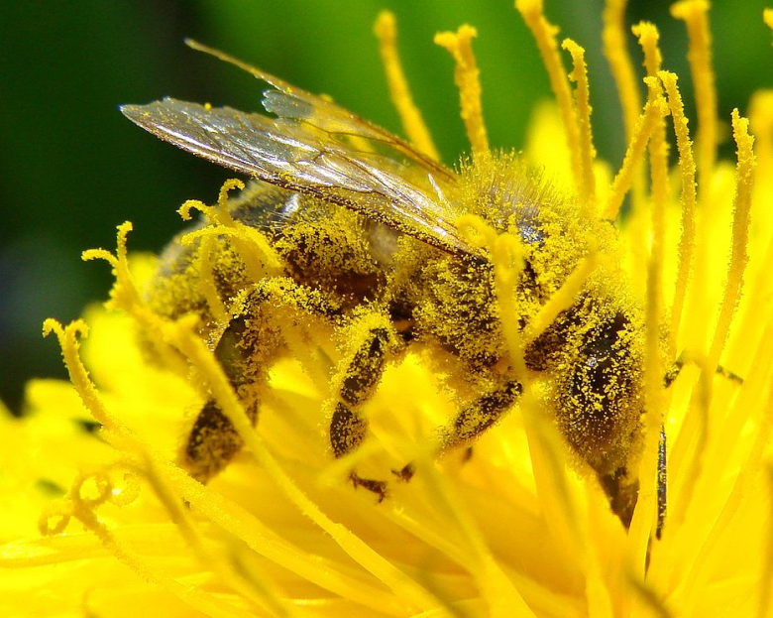
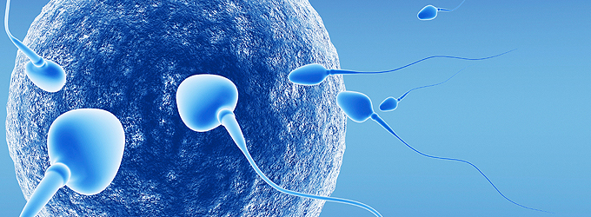
All living things reproduce and develop.

Slide 7
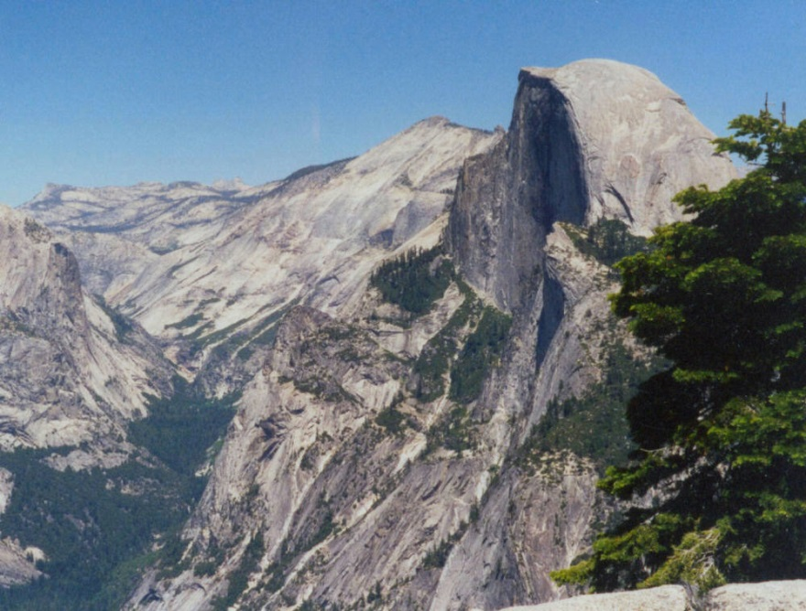
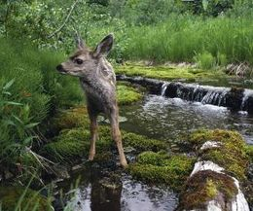
Abiotic – nonliving things
Biotic – living things

Slide 8
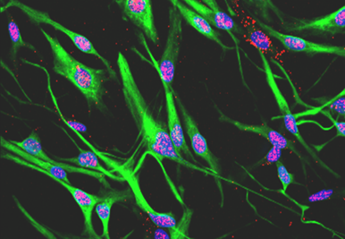
Cells

Slide 9
Cell Theory
All organisms are made of cells
All cells come from other living cells
The cell is the most basic unit of life

Slide 10
Prokaryotic vs. Eukaryotic

Slide 11
Prokaryotic cells
Do not have a nucleus or other membrane-bound organelles
All prokaryotes are unicellular
Ex: bacteria

Slide 12
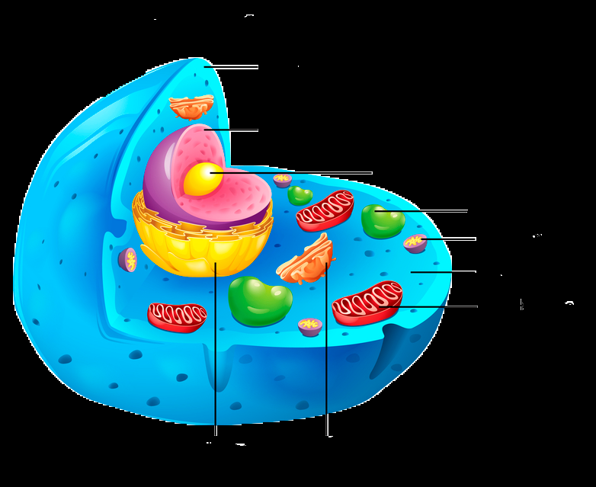
Eukaryotic cells
Have a nucleus and membrane-bound organelles
Can be unicellular or multicellular
Ex: plants and animals

Slide 13
Cell Membrane

Slide 14
Function – to control what comes in and what goes out of the cell
*** small things can go right through
*** bigger things need to go through a protein channel
*** membrane is fluid – it moves and is flexible

Slide 15
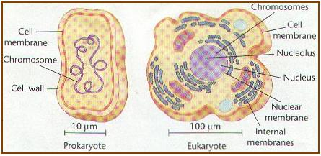
The cell membrane is in both prokaryotic and eukaryotic cells!!!!!!!!

Slide 16
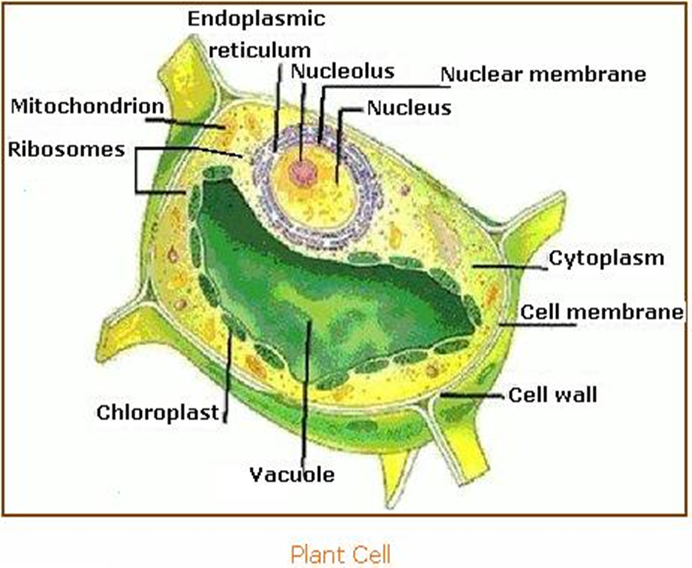
Cell Wall
Cell wall: rigid layer that gives protection and support to the cell
Is in some
prokaryotic and
some eukaryotic
cells

Slide 17
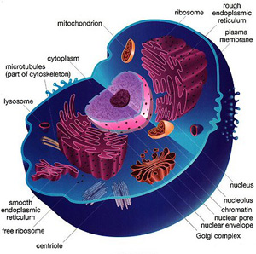
Cell Organelles
Organelle: little organ within a cell
Only within eukaryotic cells!!!!!

Slide 18
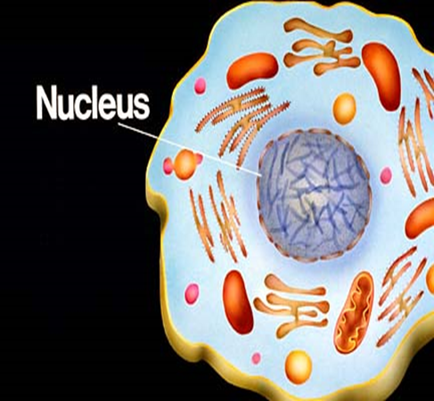
nucleus
nucleus: the organelle that stores DNA
Function – to protect the DNA

Slide 19
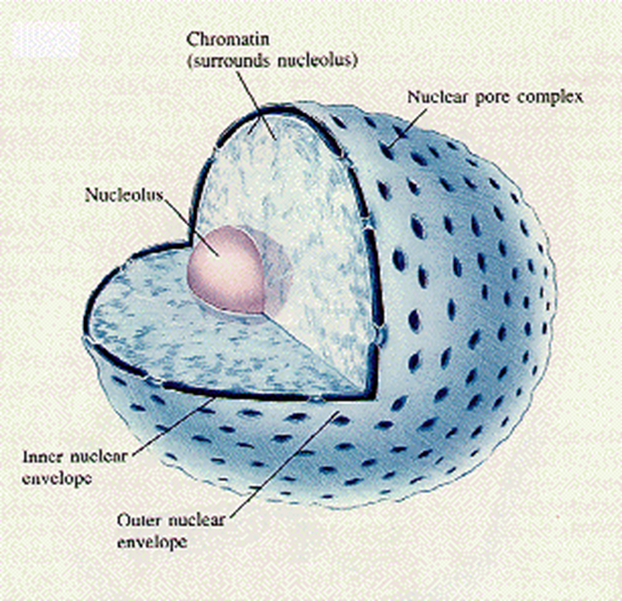
nucleolus
Nucleolus: located inside the nucleus and makes ribosomes

Slide 20
Smooth endoplasmic reticulum (sER)
Organelle that makes lipids (fats)

Slide 21
ribosome
Ribosome: organelle that links amino acids together to make proteins

Slide 22
Rough endoplasmic reticulum (rER)
Rough Endoplasmic Reticulum: (rER) organelle that processes, and distributes proteins
***rER is studded w/ ribosomes

Slide 23
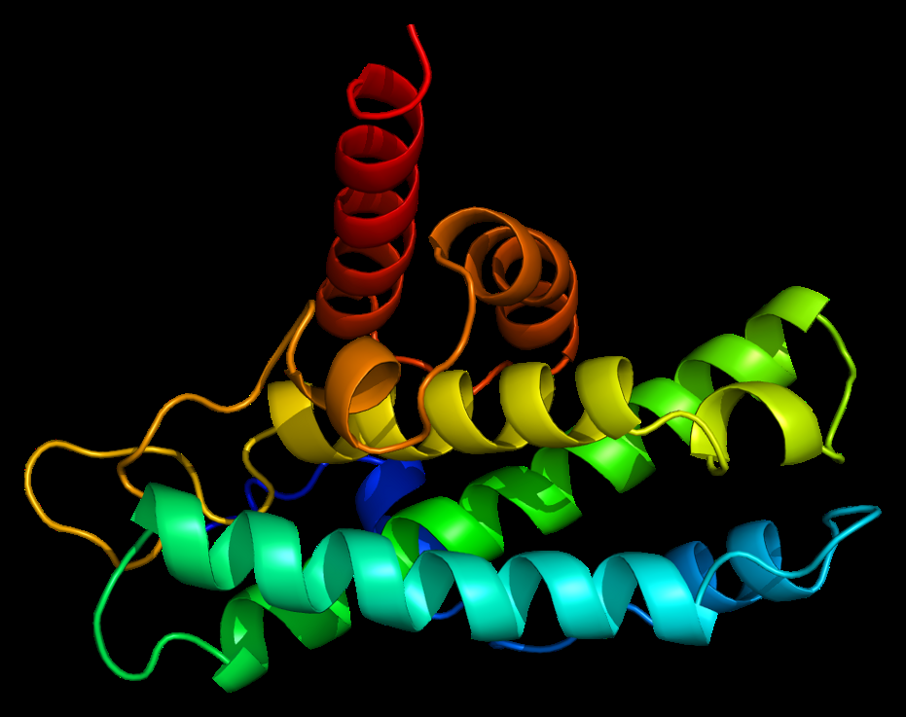

Slide 24
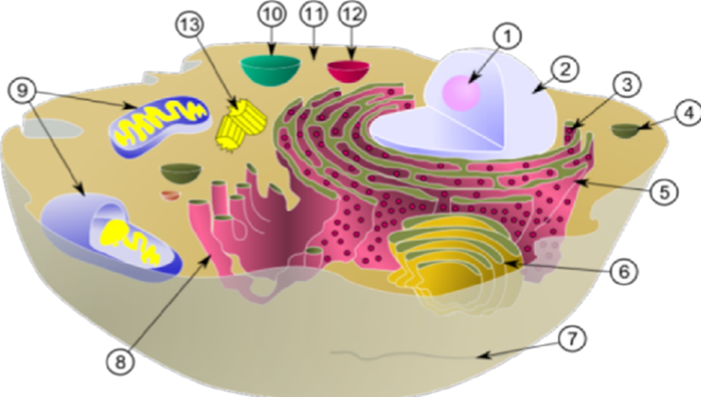
Proteins are made on the ribosomes on the rER then move inside the rER to be folded up

Slide 25
Golgi apparatus
Golgi Apparatus: organelle that sorts, and delivers proteins
Proteins end up both inside and outside the cell

Slide 26
vesicle
Vesicle: organelle that transports materials around the cell
Ex. After a protein has been made a part of the ER pinches off (Vesicle) and transports the protein to the Golgi

Slide 27
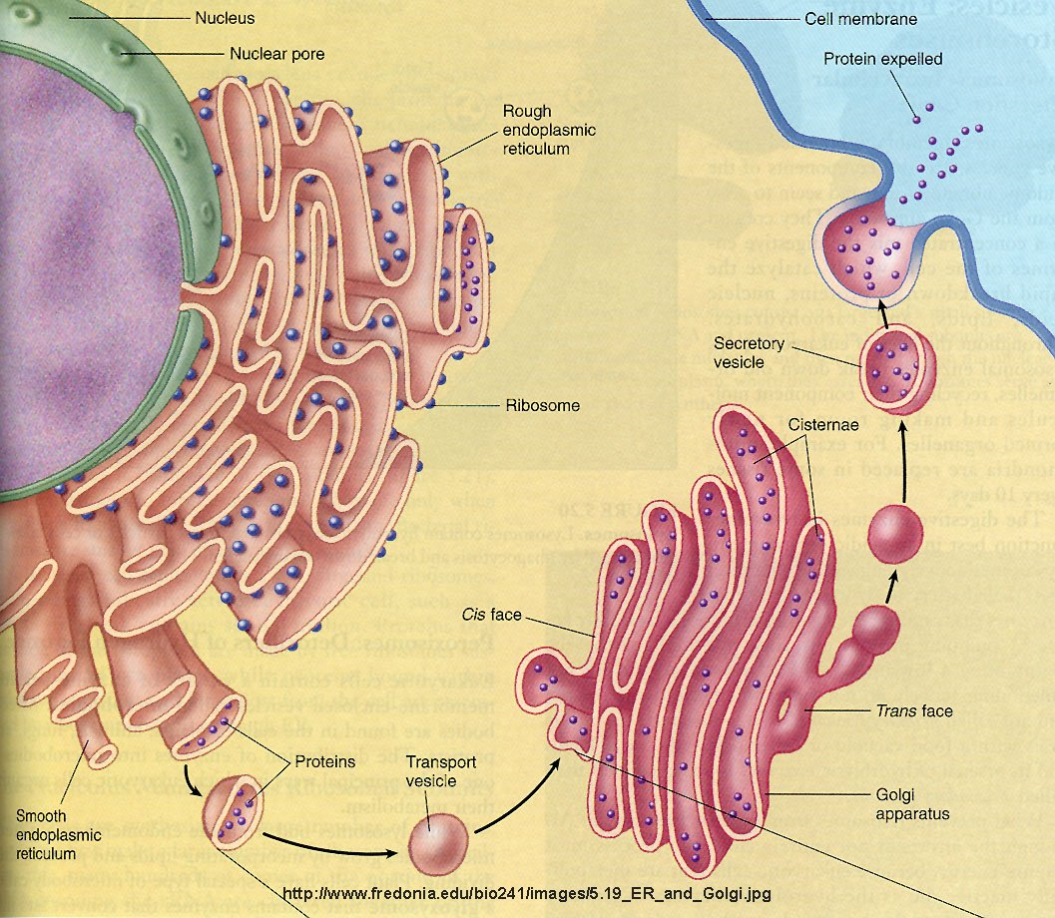

Slide 28
vacuole
Vacuole: organelle used for storage of materials needed by the cell

Slide 29
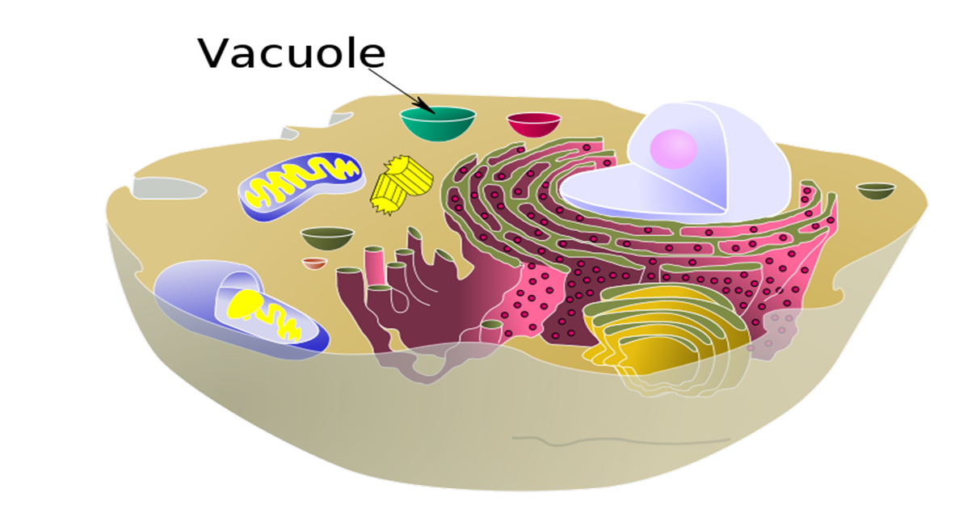
Animal cells → lots of small vacuoles

Slide 30
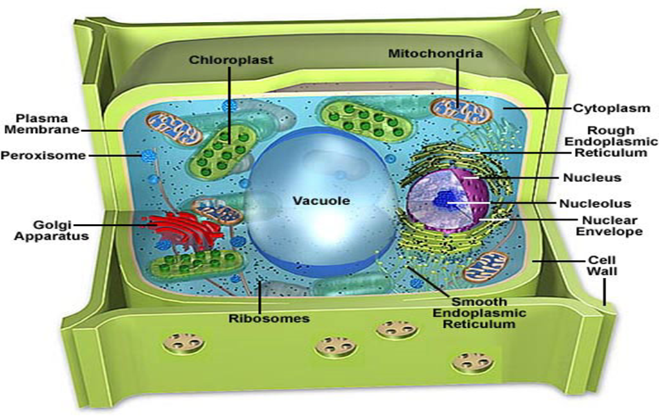
Plant cells → one large central vacuole

Slide 31
lysosome
Lysosome: organelle that contains enzymes that defend the cell from invaders and eat up worn out cell parts

Slide 32
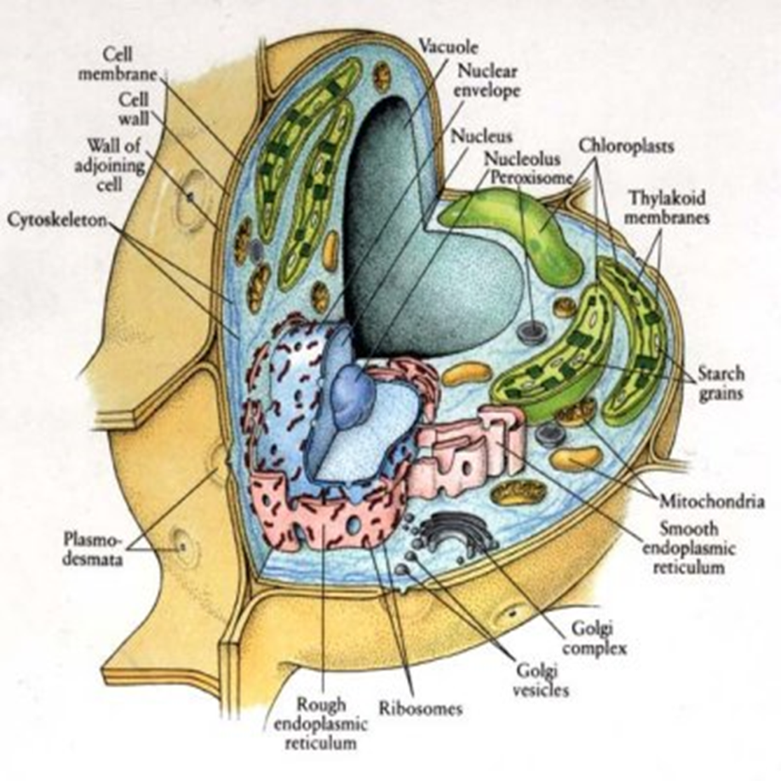
chloroplast
Chloroplast: organelle that carries out photosynthesis
Plant cells only

Slide 33
mitochondrion
Mitochondrion: organelle that makes energy for the cell
In both plant and animal cells!!!!

Slide 34
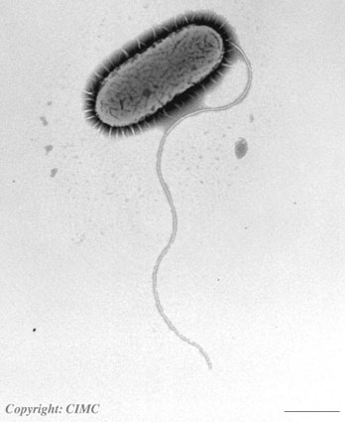
centriole
Made up of microtubules
Helps animal cells divide
Make up cilia and flagella

Slide 35
cytoskeleton
Cytoskeleton: small protein organelles that crisscross the cell that give the cell strength and allow things to move inside the cell

Slide 36
Levels of organization

Slide 37
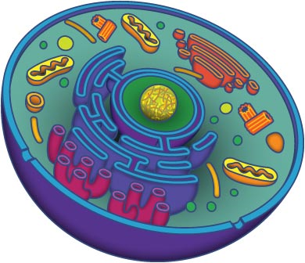
cell
Basic unit of life

Slide 38
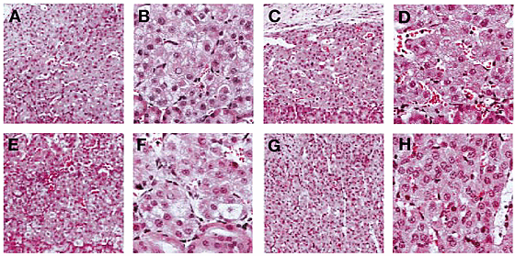
tissue
A group of cells working together

Slide 39
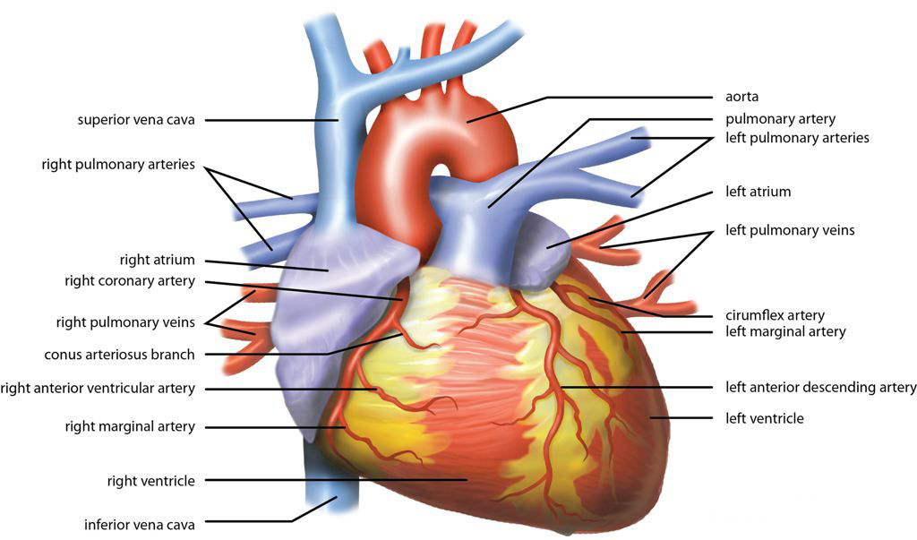
organ
A group of tissues working together

Slide 40
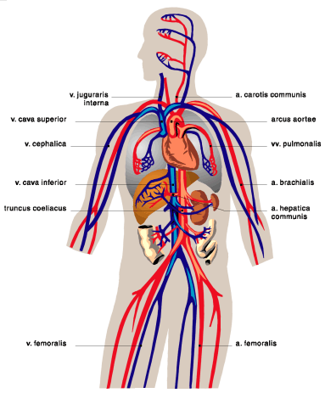
Organ system
A group of organs working together

Slide 41
organism
Any living thing

Slide 42
population
A group of the same species that live in an area

Slide 43
community
a group of different species that live in an area

Slide 44
ecosystem
both living and non living things that exist in an area

Slide 45
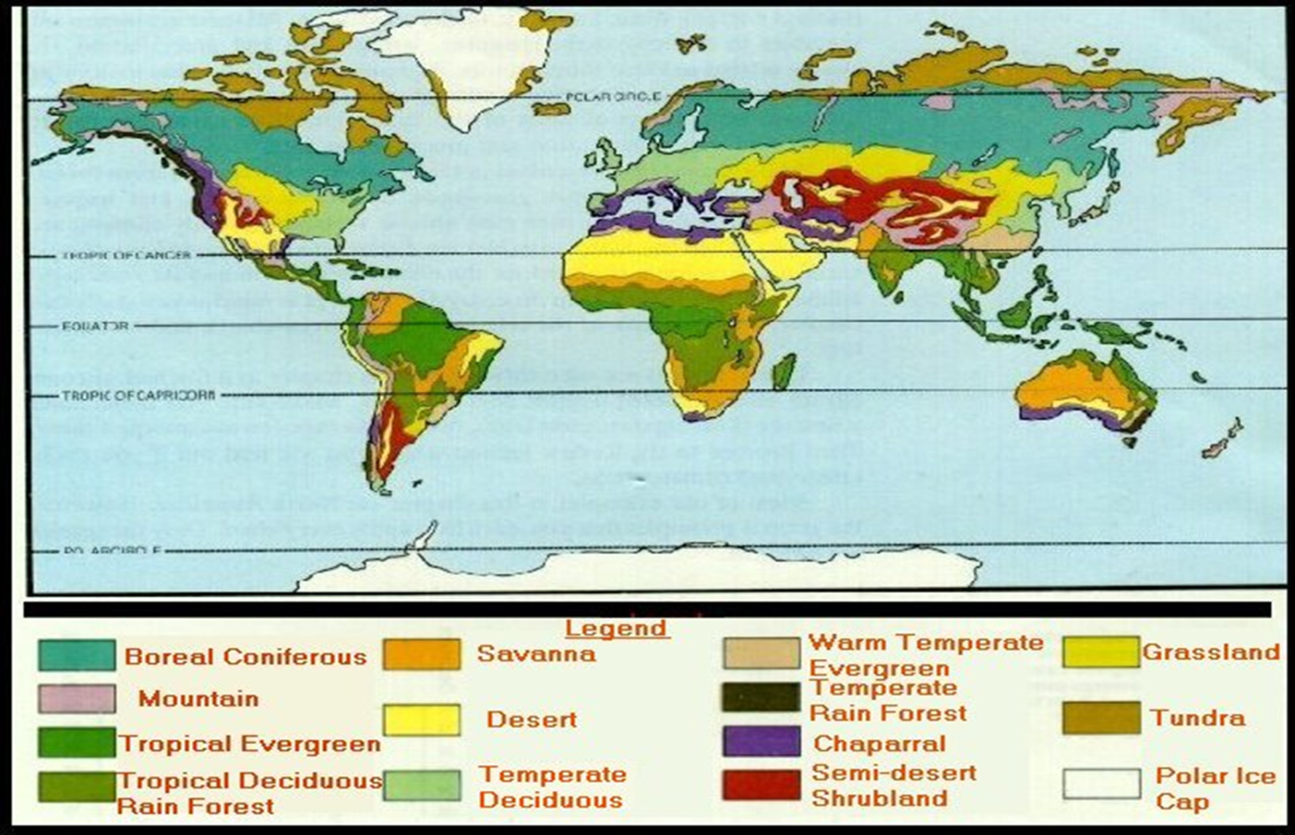
biome
major region on Earth

